Slide 1

Intro to CircuitPython
Michigan Python
fosstodon.org/@danyeaw

Slide 2
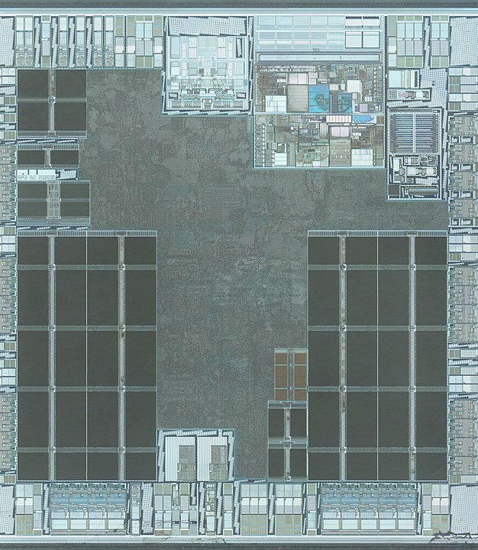
Embedded System
A computer processor, memory, and input/output that has a dedicated function as part of a mechanical or electrical system.
Modern embedded systems often use a microcontroller which is an all-in-one device that has the memory and I/O onboard
Microprocessors were traditionally made by companies like Intel and AMD, and were designed for general performance with most things like memory offboard
More recently, these lines have started to get blurred
By John McMaster, CC BY 4.0

Slide 3
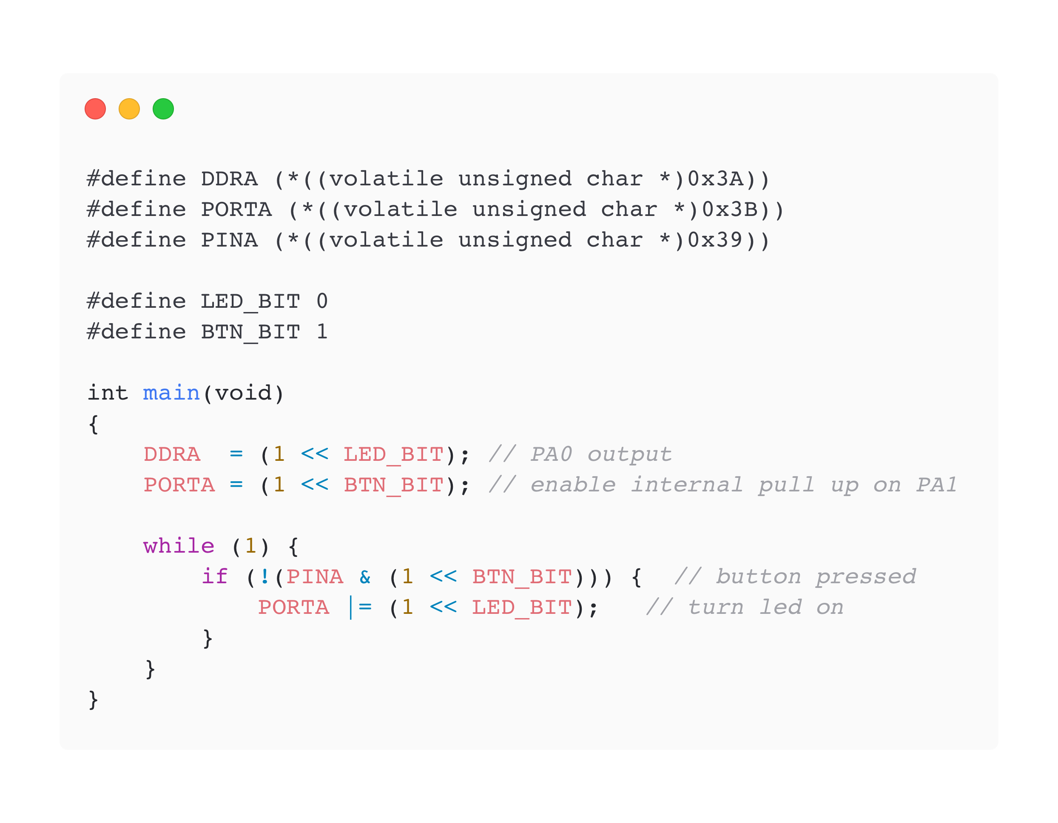
Embedded was Typically in C
Traditionally, microcontrollers were programmed in C
Atmel AVR and PIC were popular 8-bit controllers

Slide 4
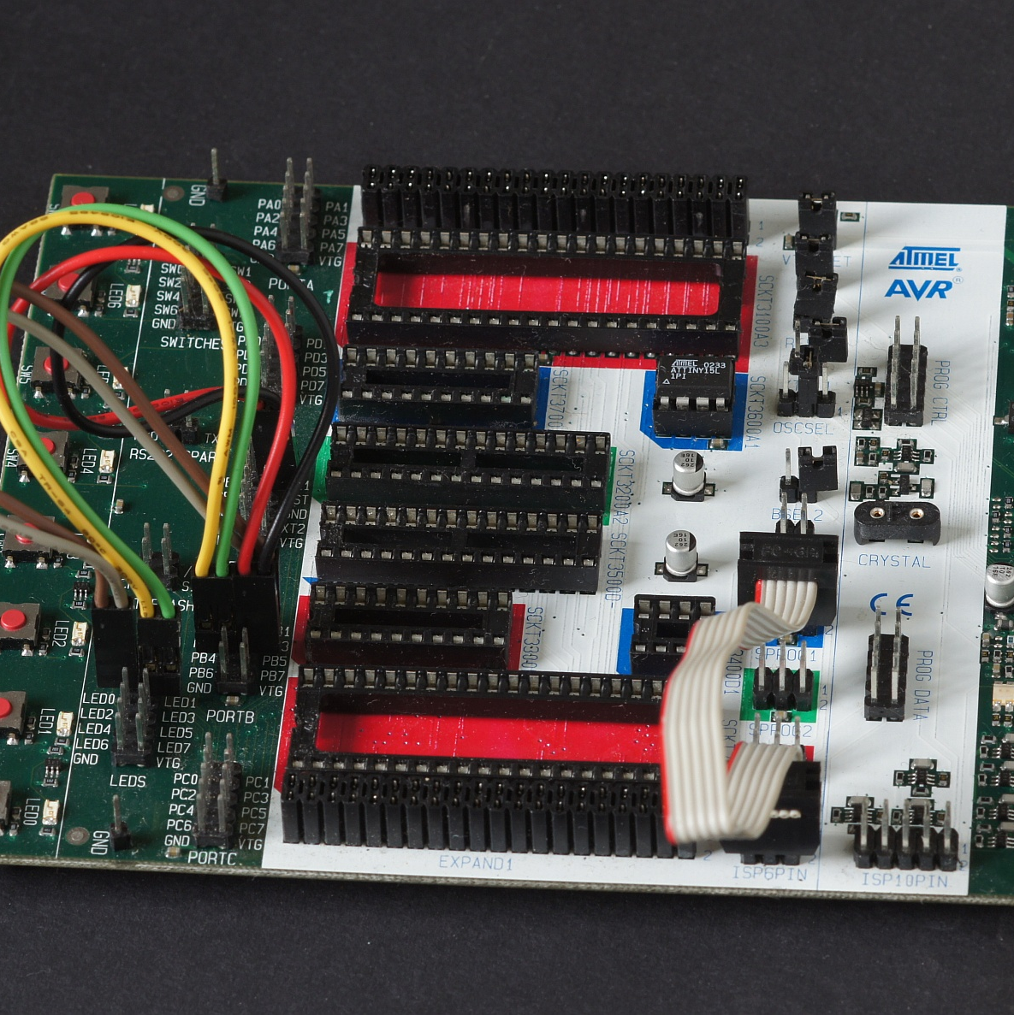
Programming Through Serial ISP
Programming to the chip was done over SPI using an in-system programming (ISP) method
On-chip debugging (OCD) support through JTAG
To get to Hello World was often very time consuming

Slide 5
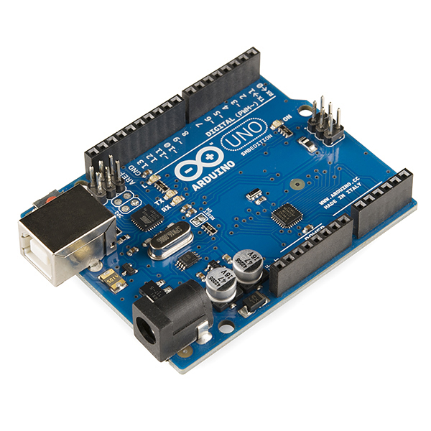
Arduino Makes Microcontrollers Easy
Single board microcontrollers
I/O pins that may be interfaced to various expansion boards called shields or breadboards
Added USB for easy programming
C code using a standardized Arduino Programming Language API, and a purpose-built IDE

Slide 6

MicroPython
MicroPython is a lean and efficient implementation of Python created in a Kickstarter by Damien George
Includes a small subset of the Python standard library
Optimized to run on microcontrollers and in constrained environments

Slide 7
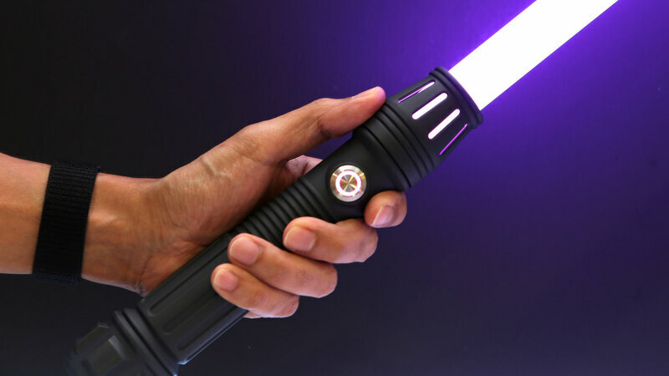
AdaFruit Creates CircuitPython
95% the same as MicroPython, but focused on beginners, education, and getting folks started super fast
Uses a USB Disk Drive to make code changes immediate
CircuitPython will restart your code when you save files to the disk drive
Consistent API across boards
Lots of examples

Slide 8

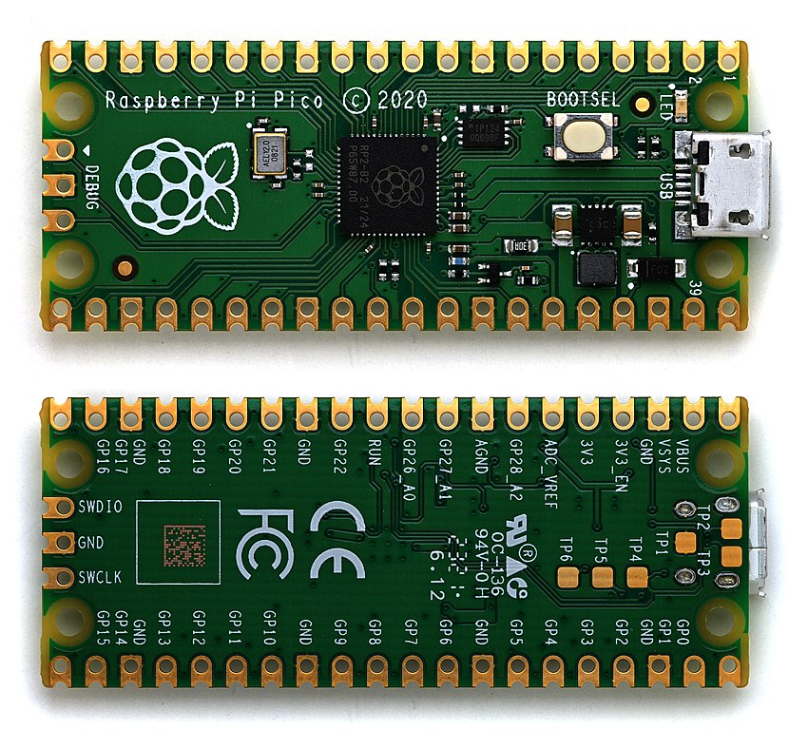
Raspberry Pi Pico
Raspberry Pi is known for single-board computers that start at about $35 and run Linux
The Pico is a microcontroller board, with a RP2040 microcontroller chip
Dual-core Arm Cortex-M0+ processor with 264kB internal RAM and support for up to 16MB of off-chip flash
A wide range of flexible I/O options includes I2C, SPI, and - uniquely - Programmable I/O (PIO)
Extremely low cost - $5

Slide 9
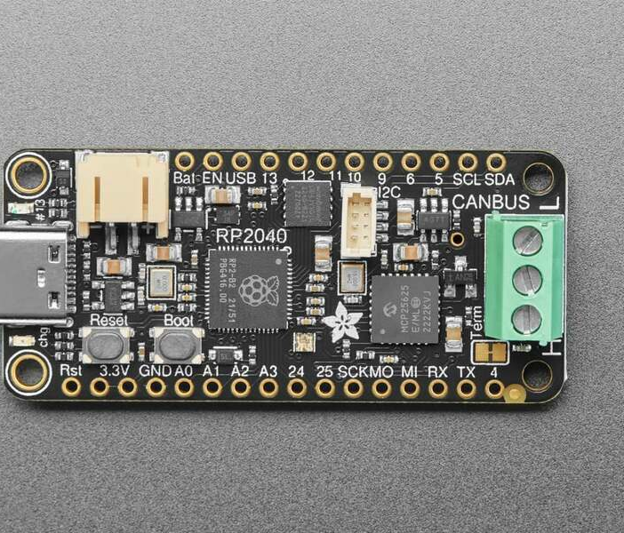
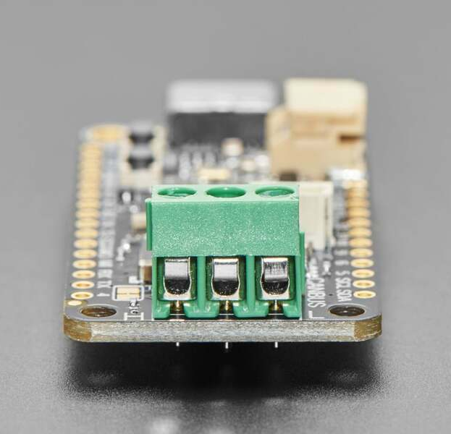
AdaFruit RP2040 CAN Bus Feather
RP2040 microcontroller, CAN chipset, and terminal blocks
The controller used is the MCP25625 (MCP2515 with built-in transceiver)
Send and receive messages in either standard or extended format at up to 1 Mbps

Slide 10

Editor Setup
Mu Editor is a simple code editor designed for getting started with embedded development
Available for Windows, macOS, and Linux (AppImage only)

Slide 11

Visual Studio Code
CircuitPython Extension
Really great integration including autocomplete, board selection, serial console, and library installation
Missing some recent boards, and there hasn’t been a new release in 8 months, so we’ll use Mu Editor for now

Slide 12
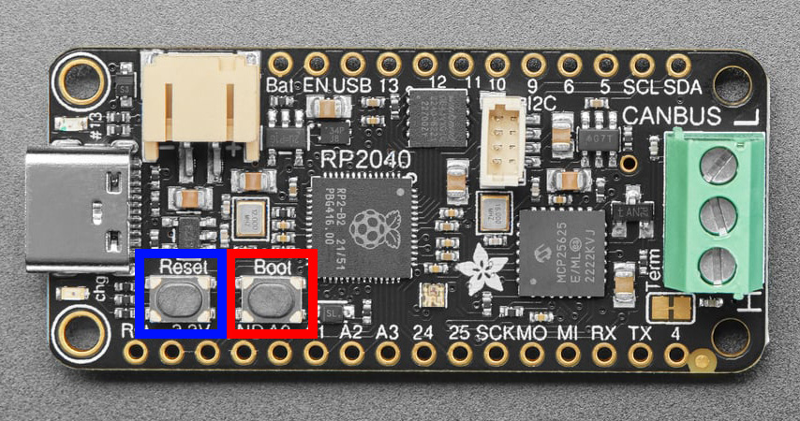
CircuitPython Installation
https://circuitpython.org/downloads
Select or search for your board (430 as of Oct 2023)
Download the USB Flashing Format (UF2) install file
Enter the bootloader by:
Holding down BOOT/BOOTSEL when powering on RP2040 based devices
Double click RESET for others like the Circuit Playground Express
A USB Disk called RPI-RP2 should appear
Drag and drop the UF2 file to the disk to install MicroPython
The disk should disappear when it finishes

Slide 13
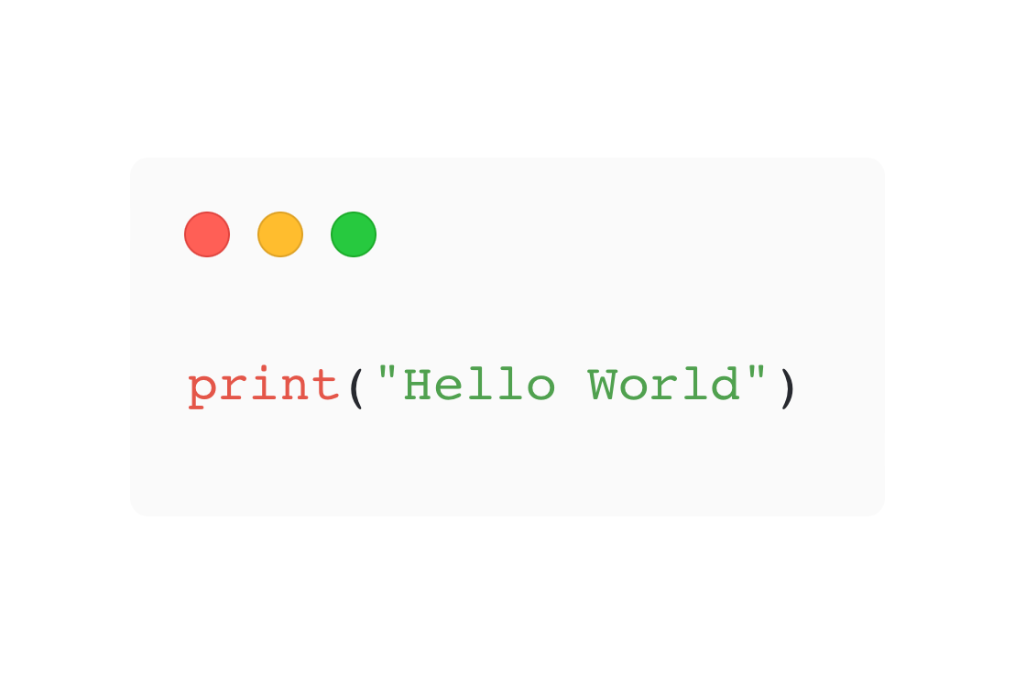
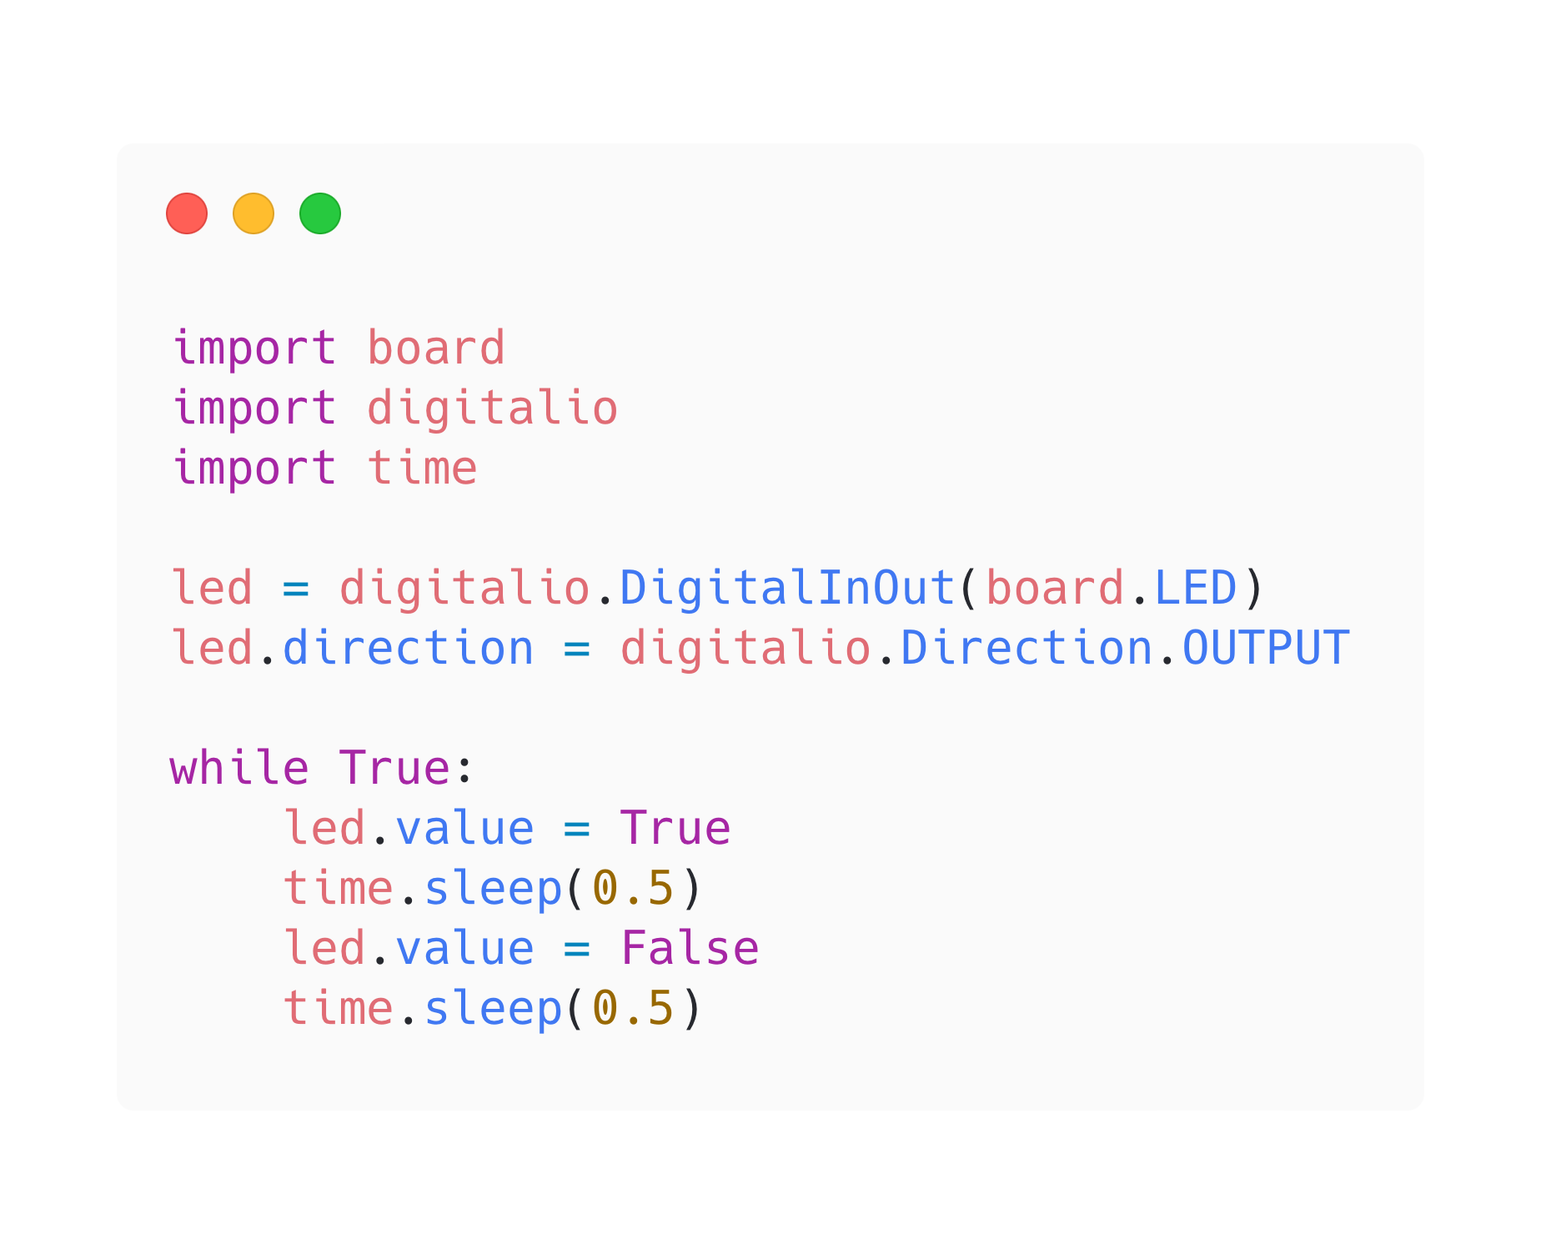
Hello World and Blinking LED

Slide 14
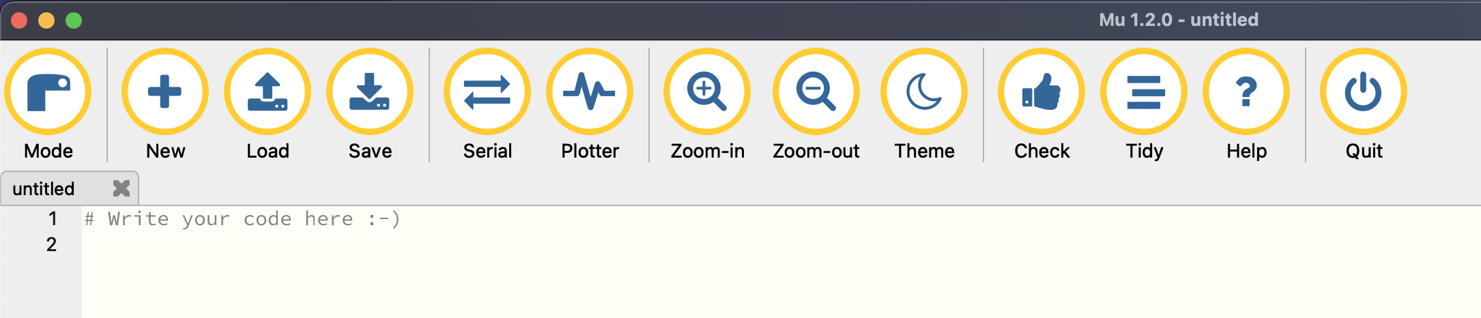
Serial Console
A serial console allows you to receive what is printed from your program like Hello World
Also used to access the Read-Eval-Print Loop (REPL)

Slide 15
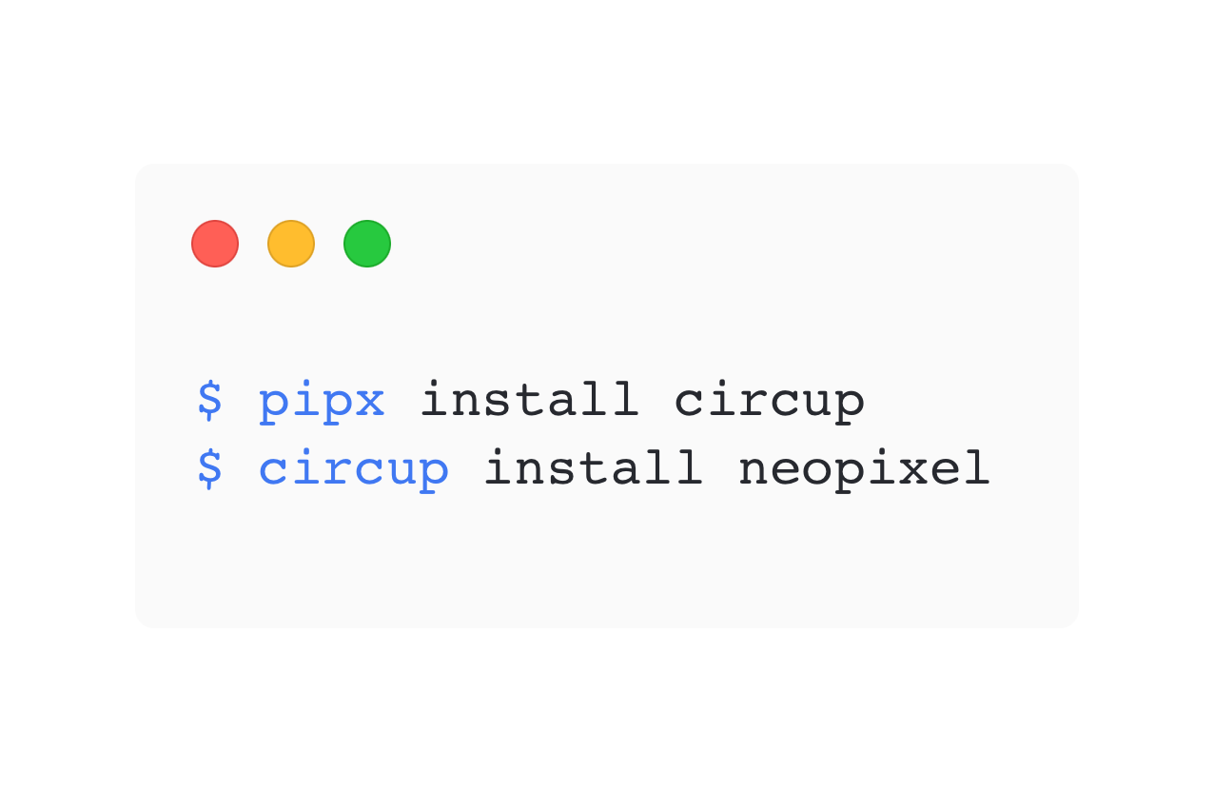
Libraries
To save space, the standard library is constrained to core functionality
To import other modules, you can add libraries to the lib folder on the USB Disk
Adafruit project often contain a Project Bundle with all files needed
CircUp can be used to install and update libraries

Slide 16
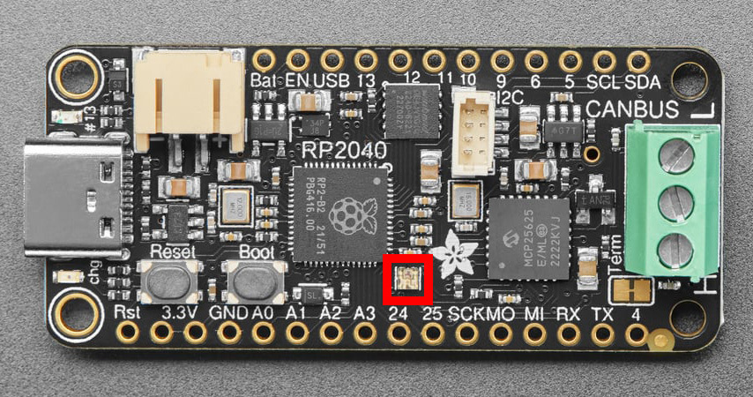
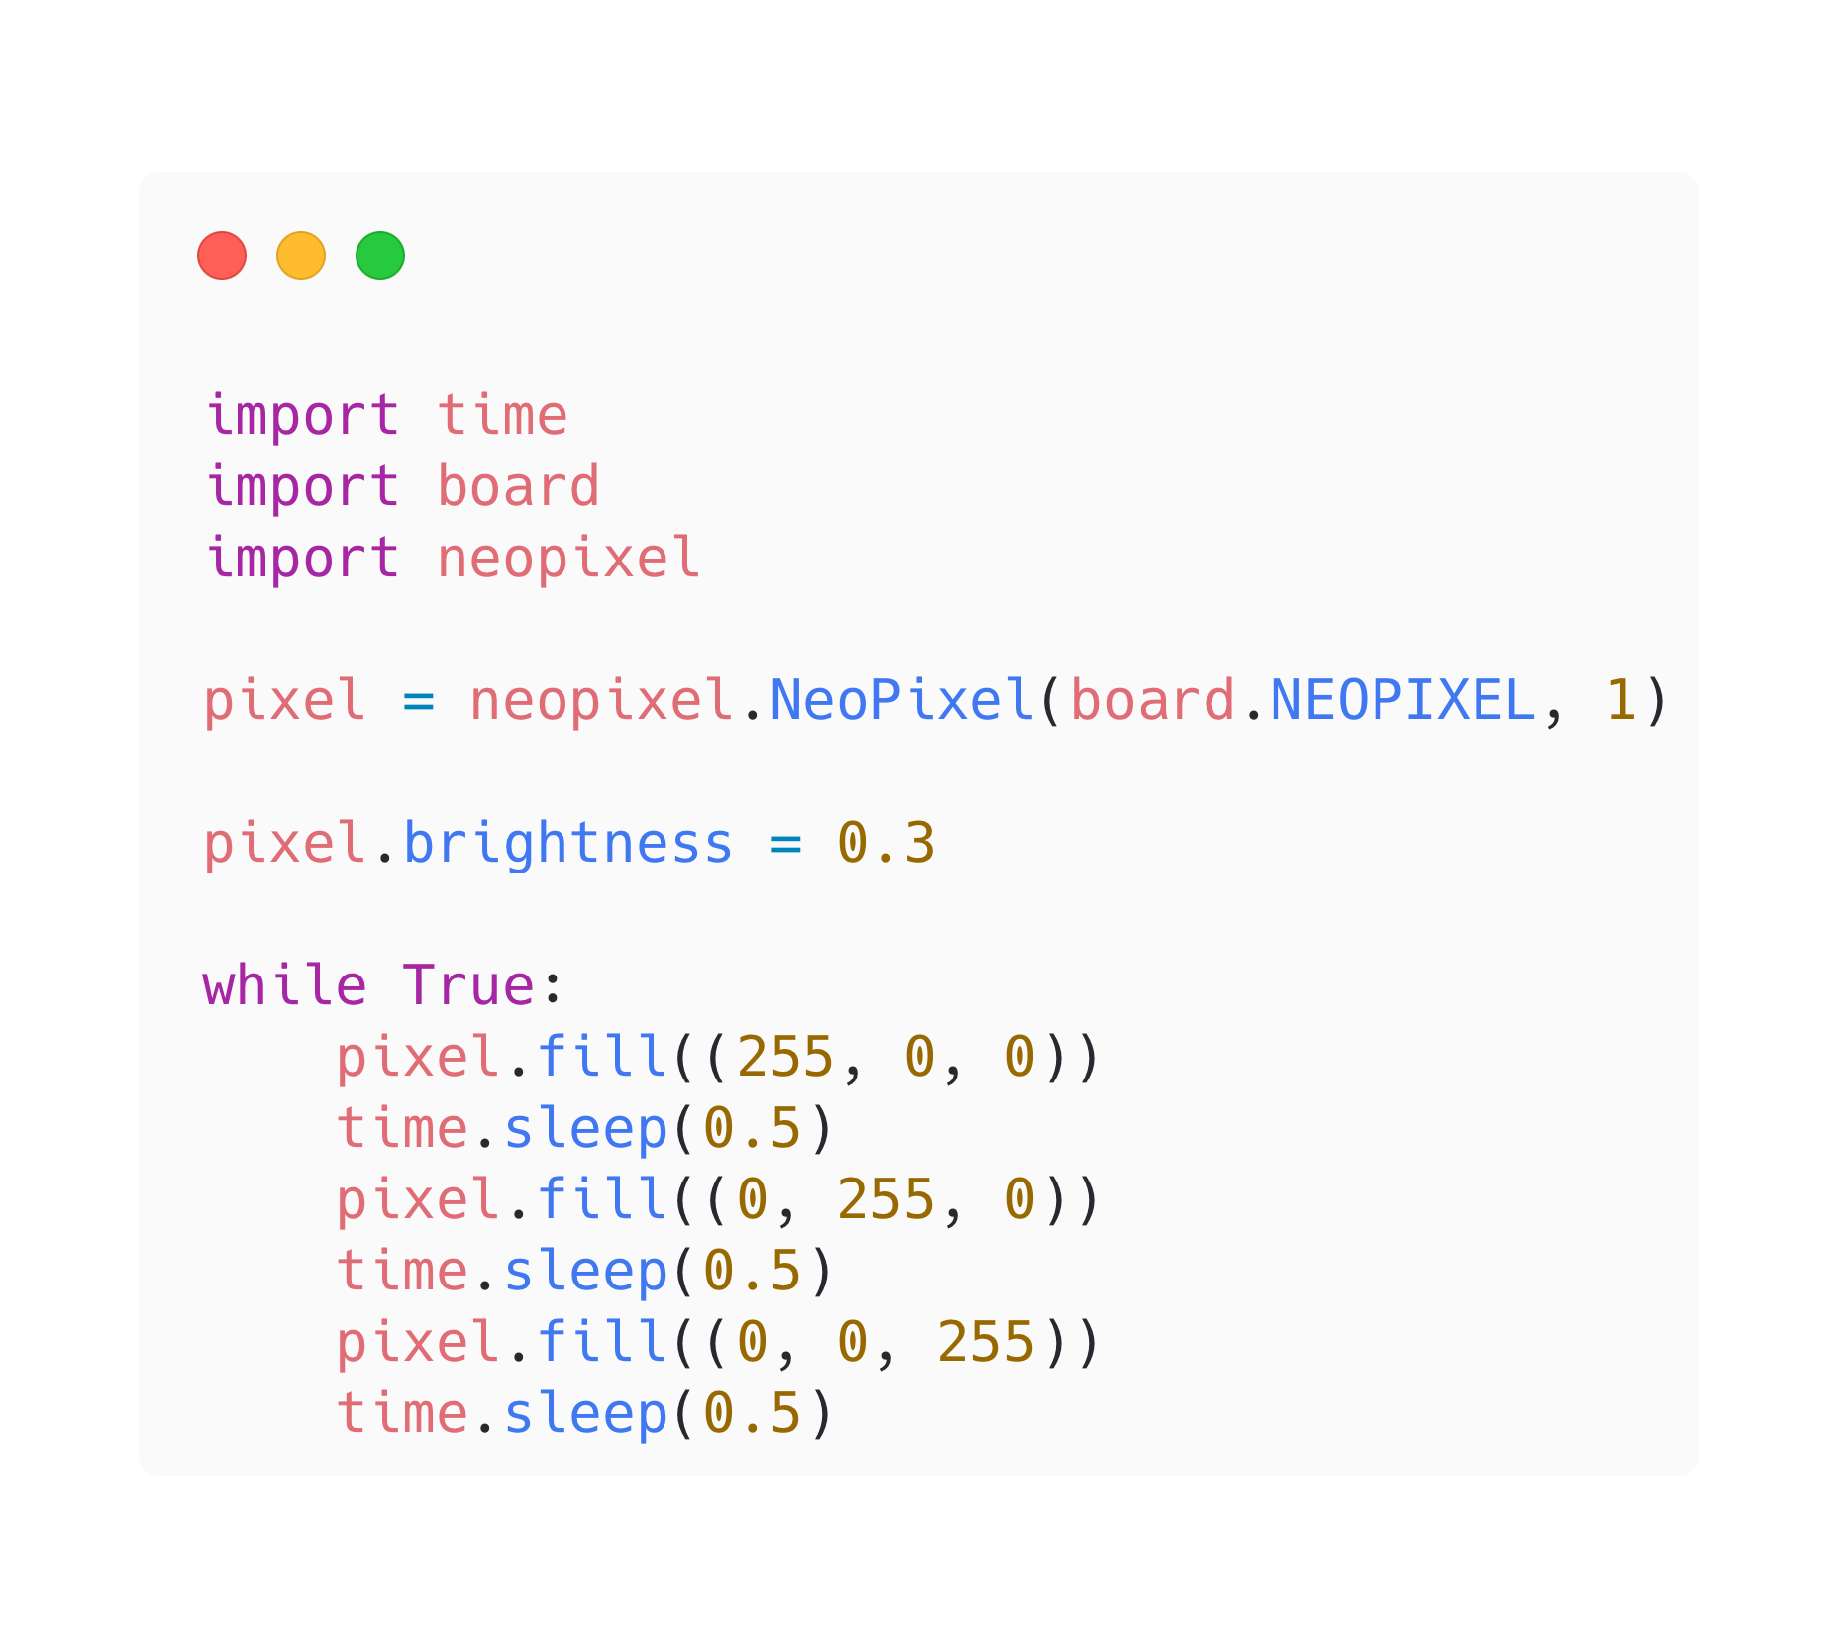
Neopixel Example

Slide 17
Let’s Install a Dev Environment
CircuitPython + Mu Editor

